Slide 1
“deMon quo vadis?”
Towards multiscale modeling!

Slide 2
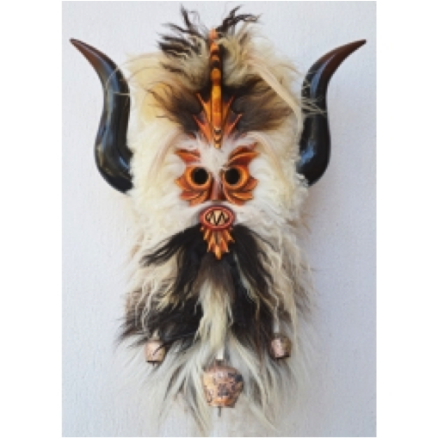
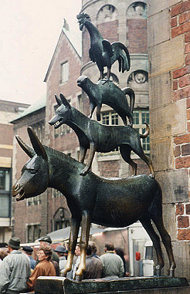
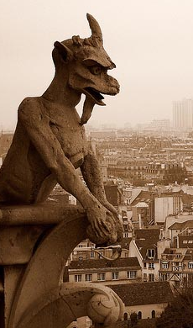
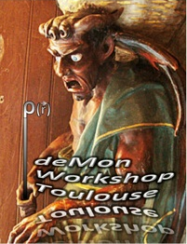
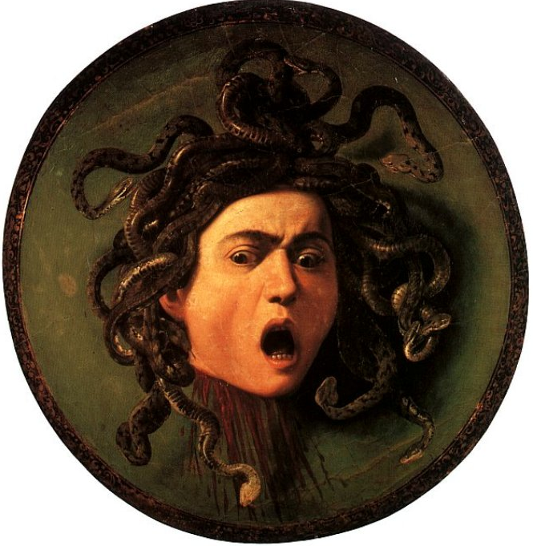
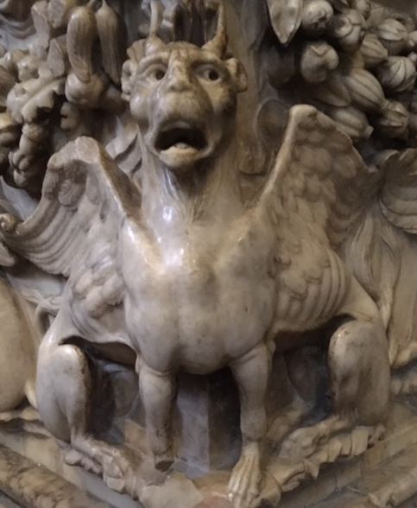
“deMon quo vadis?” Towards multiscale modeling!

Slide 4
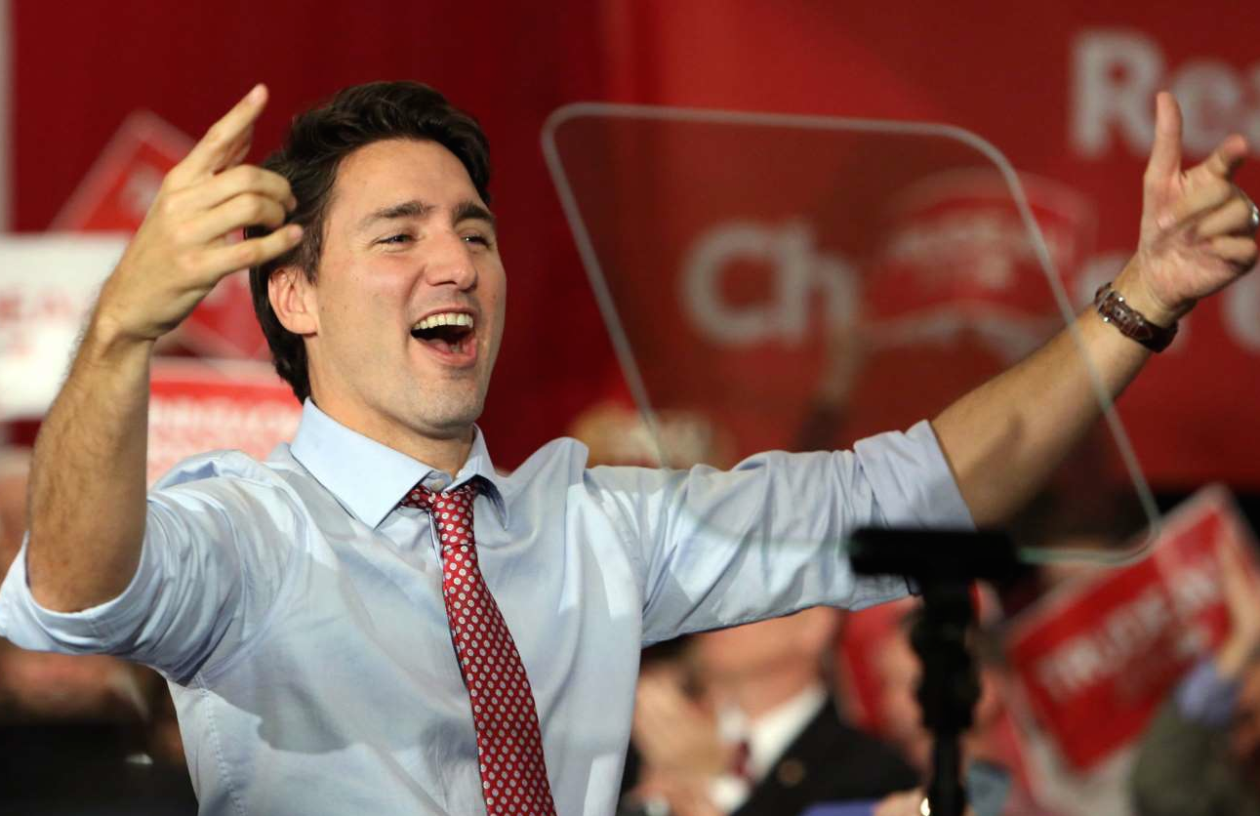

Slide 5
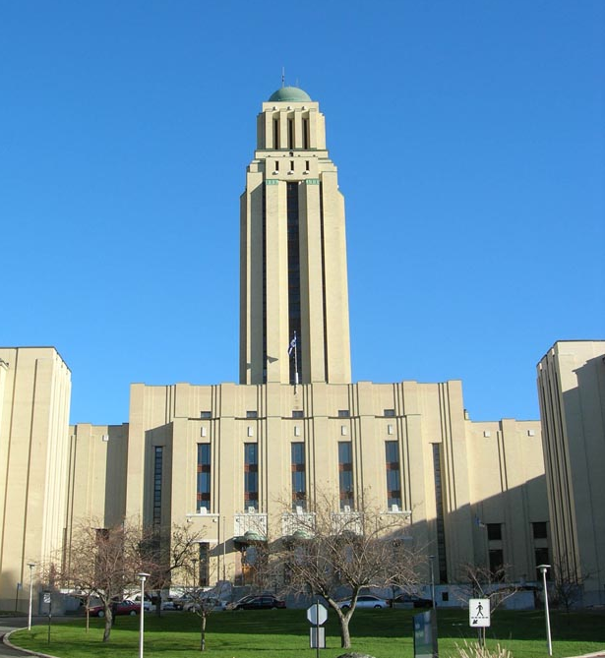

Slide 6
https://www.facsimilefinder.com/facsimiles/luttrell-psalter-facsimile

Slide 7
Features of deMon2k,
including developers‘ versions
Energy calculations (RKS, UKS, ROKS, CUKS, RHF, UHF, ROHF, CUHF)
Post Hartree-Fock propagator calculation (Roberto Flores?)
Hubbard (A)DFT+U energy and gradients
Iterative density fitting with MINRES for SCF and ADPT
Iterative perturbed density fitting with Eirola-Nevanlinna algorithm
Conventional, direct and mixed SCF
SCF with pseudo-diagonalization and localized MOs
Symmetry analysis, similarity analysis, structure parameter analysis
Symmetry adapted SCF calculations (KS, ADFT, HF and all hybrids)
Constrained DFT
MM and QM/MM droplet model with PCM
MM and QM/MM cyclic cluster model
Geometry optimization (KS, ADFT, HF and all hybrids)
Internal, Cartesian, redundant and normal space coordinates
Frequency analysis (Analytic 2nd ADFT derivatives)
IR and Raman intensities (Mixed analytic 2nd and 3rd ADFT derivatives)
Atomic weight derivatives for optimization and frequency analysis
Performance optimization of QM frequency analysis for all system sizes
QM/MM frequency analysis

Slide 8
Features of deMon2k,
including developers‘ versions
Born-Oppenheimer Molecular Dynamics (BOMD) and QM/MM MD
Parallel tempering BOMD and QM/MM MD
NPT MM and QM/MM PTMD
Property calculations along BOMD and QM/MM trajectories
Dipole autocorrelation function for IR spectra simulation
Local transition state search for MM, QM and QM/MM
Saddle interpolation (only for QM)
Intrinisc reaction coordinate for MM, QM and QM/MM
Automatized potential energy scan for ground and excited states
Hybrids for RT-TDDFT[Aurelien]
Ehrenfest MD [Aurelien]NAIN?
Features from 6.0.2 (restraints, Onsager) ?? Aurelien ? [Aurelien, Tzonka] LUIS IN NOVEMBER
QM/MM capping schemes ?? Aurelien?

Slide 9
Features of deMon2k
Including developers‘ versions
Static and dynamic polarizability and hyperpolarizability
Auxiliary density perturbation theory (ADPT)
Self-consisten ADPT for HF and hybrids (polarizability only)
NMR shielding tensor; Spin-rotation constants
Magnetizability; Rotational g-tensor
Nuclear spin-spin coupling constants
Gauge including magnetic induced current (GIMIC)
EPR g-tensor
Excited states via TD-ADFT
Direct TD-ADFT with spin flip
Excited state TD-ADFT gradients (ADPT Z-vector method)
RT-TDDFT QM/MMPol, attoscience, external fields and projectiles
Core-electron spectroscopies
MO Blocking, MOMODIFY
Core orbital localization
THz Spectroscopy
Electrostatic multipole moments
Mulliken, Löwdin, NBO, Voronoi, Becke, Hirshfeld analyses
Density of States (DOS)
Bader analysis
Critical point search of molecular fields (ρ, MESP, Δρ)

Slide 10
Features of deMon2k
Including developers‘ versions
Visualization of orbitals, densities, electrostatic potentials and
many other molecular fields
Fixed and adaptive numerical integration grids
Near- and far-field NAIs and ERIs and 1st & 2nd ERI derivatives
No limitation of l angular momentum througout the code
Parallelization of all program parts (2 step parallelization of Fock exchange)
Modified Cholesky decomposition for local Fock fitting
ScaLAPACK for parallel linear algebra
Dual parallelization with groups
Global arrays for RAM reduced ADFT
Local, GGA and meta-GGA functionals including SCAN
Access to libXC functionals
Analytic ADFT LDA, GGA and hybrid kernels (PW86, PBE)
Global (B3LYP, PBE0, M06 etc.) and
range-separated (LC, CAM, HSE06, QTP) hybrid functionals
Parallel D3 dispersion (2nd derivatives done!)
Broken symmetry calculation
MCPs & ECPs and 1st and 2nd analytic derivatives
LDA and GGA optimized basis sets
Automatic generation of all-electron and MCP/ECP auxiliary functions

Slide 11
Features of deMon2k
Including developers‘ versions
QM/MM with deMon-Charmm interface
Molecular Mechanics (OPLS, AMBER)
Metadynamics (interfaced with codes Plumed 1 and 2)
Path Integral Molecular Dynamics (interfaced with i-PI)
PIMD+PTMD with i-PI interface
Code adaptation to PGI and gfortran compilers
Single board GPU version (Jorge Martin del Campo?)
Permit multiple property calculations in one run
Ehrenfest dynamics
Multicomponent ADFT
QCNR – Quantum Chemical Nano reactor
Web site: www.demon-software.com
For sure something missed!

Slide 12
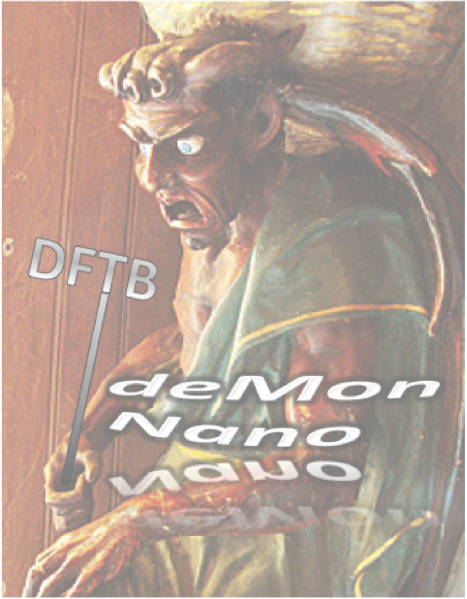
Features of deMonNano
Including developers‘ versions
Energy calculations for DFTB, DFTB2 (SCC-DFTB), DFTB3
Choice of atomic charges in DFTB2/3 potentials : Mulliken, Charge Model 3 or Weighted Mulliken
Several sets of parameters (BIO, MAT, SCC, non SCC + compatible with dftb.org parameters)
Empirical corrections for dispersion
DFTB-MM (UFF + atomic charges)
New QM/MM scheme combining DFTB and first class force fields
DFTB-FF for Argon matrix environment (Neon and Helium arriving soon)
Charge constrained DFTB (c-DFTB)
Configuration interaction DFTB (DFTB-CI)
Excited states energies and gradients via Linear response TD-DFTB
Periodic systems : k-points calculations
Coordinates : Cartesians, rigid-body coordinates Quaternions to define geometries
Visualisation of molecular orbitals

Slide 13
Features of deMonNano
Including developers‘ versions
Geometry optimization
Search for transition states (Nudged elastic band)
Molecular Dynamics, Monte Carlo, Car Parrinello MD
Thermostats : Berendsen, Nose Hoover Chain, stochastic velocity rescaling, Langevin, Andersen
Parallel tempering Monte Carlo and MD (PTMC and PTMD)
Densities of states & Heat capacities from PTMC and PTMD
Vibrational spectrum (double harmonic approximation)
Anharmonic vibrational spectrum from MD
Metadynamics (interfaced with code plumed 1 and 2)
Path Integral Molecular Dynamics (interfaced with i-PI)
PIMD+PTMD with i-PI interface
QCNR – Quantum Chemical Nano Reactor
Threshold algorithm : finding local minimal and identifying fluxes between them
Rapidly exploring Random Trees (robotic AI exploration/MOMA) available within a container
Surface-hopping non-adiabatic MD (Tully‘s fewest switches)
Real-Time-Time-Dependent-DFTB (RT-TD-DFTB)
Electronic spectrum from (RT-TD-DFTB)
Molecular dynamics with electronic friction
Website : http://demon-nano.ups-tlse.fr/

Slide 14
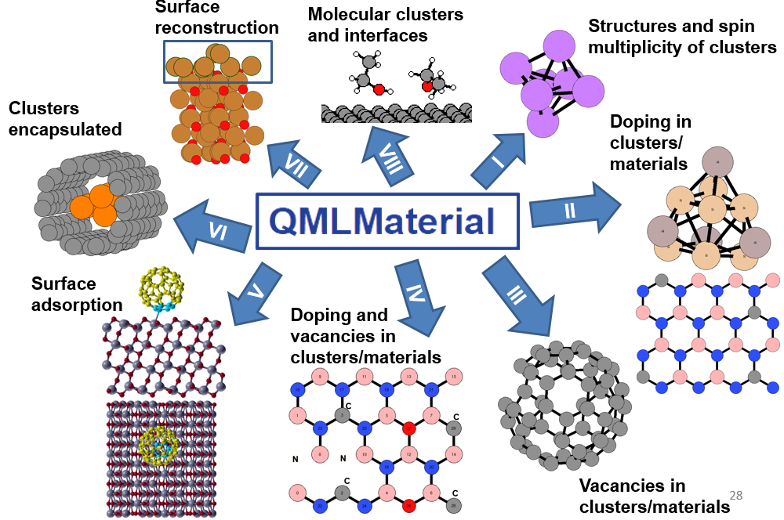
QMLMaterial.3.7
Features of QMLMaterial
(Quantum) Active learning (AL) with the regressions:
classical and quantum Gaussian process (GP),
neural network (ANN) and
classical and quantum support vector regressor (SVR)
Uncertainties quantifications:
from Bayesian statistics, cross-validation
and bootstrap.
Avaialable molecular or periodic descriptors:
many bady tensor representation (MBTR),
smooth overlap of atomic positions (SOAP),
Coulomb matrix (CM),
Ewald sum matrix (ESM),
sine matrix (SM).
PCA for dimensionality reduction.
Sampling the unexplored space of clusters by:
plane-cut-splice
rattle and permutation;
genetic algorithm operators.
Interface with the calculators: deMon2k,
DFTB+, ORCA,
XTB, Quantum ESPRESSO, deMon-Nano.
AL for automatic structural determination of:
doping of clusters (+spin multiplicity search);
vacancies in clusters;
doping or vacancies in solids;
doping and vacancy in nanoparticle or solids;
atomic clusters (+spin multiplicity search);
adsorbate search on surfaces;
atomic clusters interfaces: surfaces, nanotubes, etc;
surface reconstruction;
Molecular clusters and reactants
on surfaces/ interfaces.

Slide 15
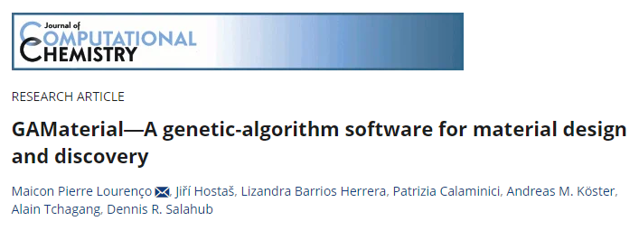
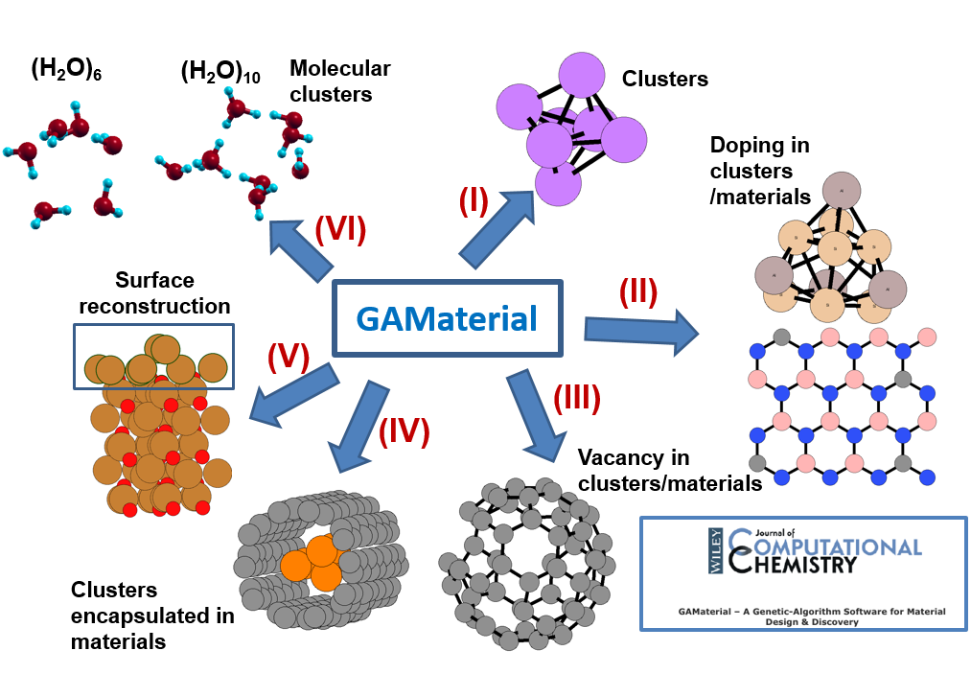
GAMaterial.3.4
Features of GAMaterial
GA for automatic structural elucidation of:
atomic clusters,
doping or vacancies in clusters or solids;
atomic clusters interfaces: surfaces, nanotubes, etc;
surface reconstruction;
molecular clusters and interfaces.
Machine learning models to accelarate the GA:
Gaussian process (GP),
neural network (ANN) and
support vector regressor (SVR).
Available molecular or periodic descriptors:
many bady tensor representation (MBTR),
smooth overlap of atomic positions (SOAP),
Coulomb matrix (CM),
Ewald sum matrix (ESM),
sine matrix (SM).
Sampling the unexplored space of clusters by:
plane-cut-splice,
rattle and permutation
genetic algorithm operators.
Interface with the calculators: deMon2k,
DFTB+, ORCA,
XTB, Quantum ESPRESSO.

Slide 16
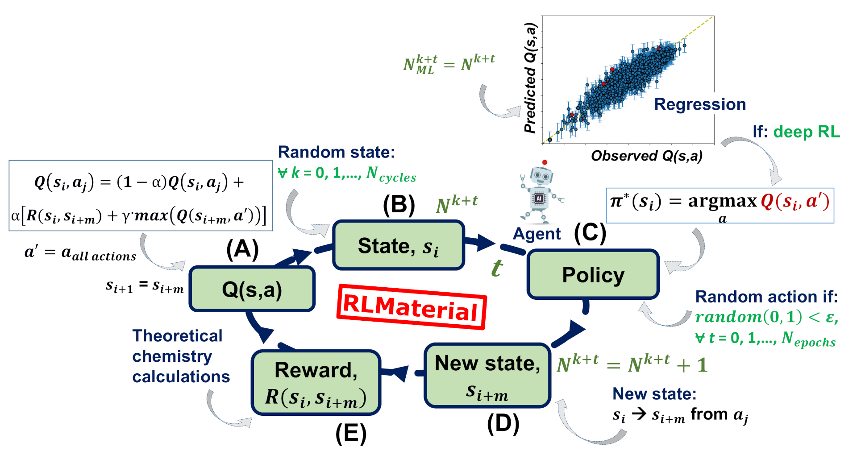
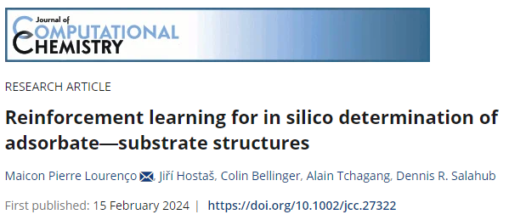
RLMaterial.0.3
Features of RLMaterial
Reinforcement learning (RL) for adsorbate@surfaces:
Q-learning;
deep Q-learning using nerual network and gradient boosting;
transfer-learning between different chemical systems;
transfer-learnig between different DFT and theoretical levels.
Avaialable molecular or periodic descriptors to approximate the Q-table:
description of the adsorbate@substrate states:
translations + rotations;
many bady tensor representation (MBTR);
smooth overlap of atomic positions (SOAP).
Interface with the calculators: deMon2k,
DFTB+, ORCA,
XTB and Quantum ESPRESSO.

Slide 17
Features of MLChem4D
MLChem4D.3.2.2
MLChem4D for optimum experimental design in chemistry and more:
(Quantum) Active learning (AL) with the regressors:
Gaussian process (GP),
neural network (ANN) and
classical and quantum support vector regressor (SVR).
Uncertainties quantifications:
from Bayesian statistics, cross-validation
and bootstrap.

Slide 18
So, where are we going?

Slide 19
Multiscale modeling of chemical reactions in complex environments.

Slide 20
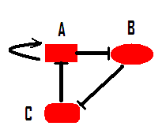
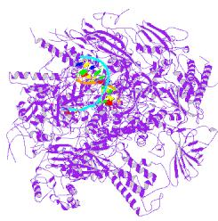
The Multiscale Map
Relationships Between Steps
KMC
Molecular Recognition
MM
Chemical Reactions
QM

Slide 21
The methodological zoo with lovely animals…
MS FBA
deMon-STOBE
CHARMM-deMon
deMon – NMR - RESPECT
deMon SIBFA, GEM
KSCED
PM6
UA-QCMD
REAXFF
deMon2k, deMonNano...
GGA, meta-GGA,DFT-D, hybrid, DFTB
deMon FOR TEACHING
Am1-dPHOT
CCM
E- TRANSFER
KINETIC MONTE CARLO
TDDFT
BORN-OPPENHEIMER MD
CONSTRAINED DFT

Slide 22
The methodological zoo with lovely animals…
MS FBA
deMon-STOBE
CHARMM-deMon
deMon – NMR - RESPECT
deMon SIBFA, GEM
KSCED
Machine Learning
Quantum Machine Learning ?
PM6
UA-QCMD
REAXFF
deMon2k, deMonNano...
GGA, meta-GGA,DFT-D, hybrid, DFTB
deMon FOR TEACHING
Am1-dPHOT
CCM
E- TRANSFER
KINETIC MONTE CARLO
TDDFT
BORN-OPPENHEIMER MD
CONSTRAINED DFT

Slide 23
ACTION ITEMS – HOMEWORK!
Look at the Action items (on workshop web site)
Send email(s) to me (dsalahub@ucalgary.ca)
Brief description of progress (identify by line number).
Any action items that we can simply delete
Suggestions for new action items
In wrap-up section we can discuss (time limited)
Finalize by email post workshop

